Slide 1

P peline
The Data
Data Quality
© Jennifer Mankoff
The Data Pipeline; HCII; Spring 2014

Slide 2
Four C’s of Data Quality
Is your data Complete?
Is your data Coherent?
Is your data Correct?
Is your data aCcountable?

Slide 3
Recommended Reading
The Bad Data Handbook (McCallum): O’Reilly Press
Making Sense of Data: A practical guide to Exploratory Data Analysis and Data Mining
Tukey: Exploratory Data Analysis

Slide 4
But first… What type of data do you have?
How is it structured; if at all?
Does it have multiple tables or just one?
Is it designed for machine consumption or human consumption?
Is it in a database? multiple files or one file?
How are missing values represented?
What are the fields and values?

Slide 5
Amy’s Mouse Data: Text log files
0,0,CBT:-- --( )--6:5.23:468--Window Created
0,0,CBT:-- --( )--6:5.23:562--Window Created
0,0,CBT:-- --( )--6:5.23:578--Window Activated--(HCII Logging Setup Screen)--main size:--(556,309)--location:--(405,212)
0,0,CBT:-- --( )--6:5.23:609--Window Created
0,0,CBT:-- --( )--6:5.23:609--Window Created
0,0,CBT:-- --( )--6:5.23:609--Window in focus--gotFocus--size:--(445,39)--location:--(500,0)
0,0,MOUSE:----()--6:5.24:46--(457, 545)--MOUSE MOVED--time:--45640--0--0
0,1,CBT:-- --( )--6:5.24:62--unrecognized symbols--unknownWinEvent--size:--(445,39)--location:--(500,0)
0,1,CBT:-- --( )--6:5.24:78--unrecognized symbols--unknownWinEvent--size:--(445,39)--location:--(500,0)
0,1,MOUSE:----()--6:5.26:250--(457, 543)--MOUSE MOVED--time:--47921--0--0
0,2,CBT:-- --( )--6:5.26:250--unrecognized symbols--unknownWinEvent--size:--(445,39)--location:--(500,0)
0,2,MOUSE:----()--6:5.26:250--(457, 543)--MOUSE MOVED--time:--47921--0--0
0,3,MOUSE:----()--6:5.26:265--(458, 541)--MOUSE MOVED--time:--47937--0--0
0,4,CBT:-- --( )--6:5.26:265--unrecognized symbols--unknownWinEvent--size:--(445,39)--location:--(500,0)
0,4,MOUSE:----()--6:5.26:265--(459, 539)--MOUSE MOVED--time:--47937--0--0
0,5,CBT:-- --( )--6:5.26:265--unrecognized symbols--unknownWinEvent--size:--(445,39)--location:--(500,0)
0,5,MOUSE:----()--6:5.26:281--(460, 535)--MOUSE MOVED--time:--47953--0--0
0,6,CBT:-- --( )--6:5.26:281--unrecognized symbols--unknownWinEvent--size:--(445,39)--location:--(500,0)
Notes:
Major parsing effort to create tables!
The original logs did not have consistent logging formats and improper delimiting which has resulted in issues with parsing. Some of these have been fixed, but others may not yet have been found. Typical symptoms include the subfields not correctly matching the expected value from the original log file. Typical errors are caused by log file field delimiters appearing within a field (causing incorrect field tokenization). Other errors caused by unknown and inconsistent log line formats. Different types of log lines had differing line formats and these sometimes changed.

Slide 6
Amy’s Data Tables
One-time & Qualitative data about participants (participant number; ‘diagnosis’; performance on initial test; etc)
Session data (summary)
Event data (details)
Segment data (summary)
Keyboard key down (if any)?
Mouse features
Target features
…

Slide 7
What Type of Data in Each Field?
Constant (e.g., mouse gain)
Continuous Data (e.g., mouse location)
Discrete Data (often scales)
(e.g., slip/no slip on this interaction)
What are the units?
Notes:
Interval: Scales that describe values where the interval between the values has meaning.
Ratio: Scales that describe variables where the same difference between values has the same meaning (as in interval) but where a double, tripling, etc. of the values implies a double, tripling, etc. of the measurement. An example of a ratio scale is a bank account balance whose possible values are $5, $10, and $15. The difference between each pair is $5 and $10 is twice as much as $5. Since ratios of values are possible, they are defined as having a natural zero.

Slide 8
Scales of Measurement
Nominal (e.g., Diagnosis; Application used)
Ordinal (e.g., “low” “medium” “high”)
Interval (e.g., Index of Difficulty)
Ratio (e.g., Target Sizes)

Slide 9
What Role Does This Field Play?
Descriptor / Feature: predictive of labels (e.g. Click Duration)
Response / Label:
outcome of prediction
response to an intervention / question
(e.g. Diagnosis)
Notes:
Example scripts to address each of these?

Slide 10
Questions about Completeness
Appropriate Data: Does the data you have match the questions you want to answer?
Missing Data: Data does not exist because it was never obtained or was lost
Reporting error: The sensor (or respondent) is incorrect

Slide 11
Solutions and Issues for Appropriate Data
Look ahead … to the questions you’d like to answer
Reason back … to the data you’d need to collect

Slide 12
Solutions and Issues for Missing Data
Impute the data using statistics
Find an alternative source
Reweight the data to reflect the changed sample
Notes:
Example: we had data files whose names matched one participant but the directories matched a different participant name. The directories were done by hand, the file names were machine-generated. Which would you trust?

Slide 13
Solutions and Issues for Reporting Errors
Finding the error:
May collect the data twice and compare
Find an alternative source to compare
Can you look for sources of bias across variables (surveys with only round values; people who report everything in round numbers)
How does the way you collect data affect reporting errors?
Assessing its impact:
Is it random or does it introduce bias
Is it more likely in some variables than others

Slide 14
Is your Data Coherent?
Does the data “add up”?
Does it make sense relative to itself?
Examples
Non number in a numeric field
Month field has something other than a month
Email has no @
Hourly data adds up to 24 hrs per day
Etc.

Slide 15
Nominal/Ordinal Field Data Inspection
How many are there?
Are they spelled consistently?
What is the frequency distribution of different values?

Slide 16
Interval/Ratio Field Data Inspection
Calculate min/max/mean; Make a boxplot!
- are there unexpected negative values? Very large targets/long motions/low velocity?
What outliers do you see?
- could represent measurement errors
- could be genuine
Make a histogram!
- can you see unexpected patterns (e.g. due to clutching)
- what does the distribution look like?
Notes:
Need domain expertise to differentiate!

Slide 17
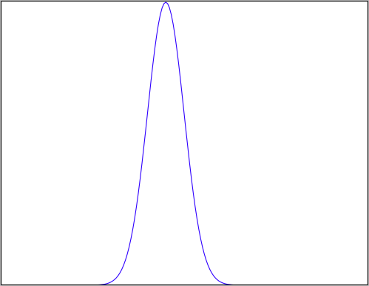
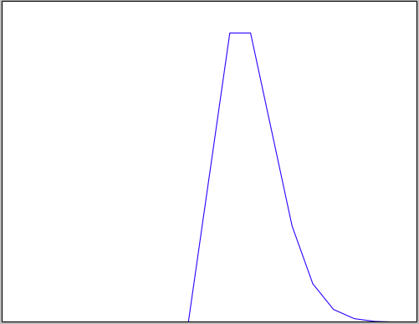
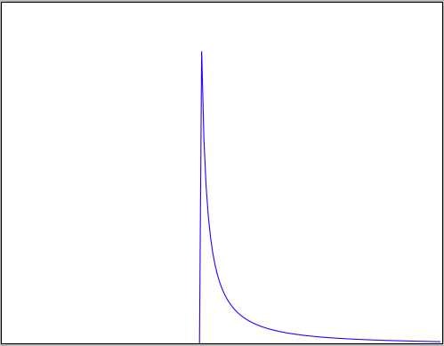
Checking a distribution
Histogram (eyeball)
“Goodness of Fit” (statistical test)
Does assumptions match your data?
Example distributions:
Normal
Poisson
Log Normal
Notes:
Example

Slide 18
What your distribution implies: Normal Distribution
Properties:
No long tail (bell shaped)
Symmetric
Mean median & mode equal & in the middle
~68% within 1 SD of mean
~95% within 2 SD of mean
Almost all lie within 3SD of the mean
Histogram looks bell shaped
Notes:
Example

Slide 19
When might we expect a Normal distribution?
Central limit theorem: Sum of independent and identically distributed random variables will converge to normal

Slide 20
Random Variable
Value varies (e.g. possible outcomes of an experiment)
Modeled as a distribution
Discrete values (“Probability Mass Function”) - typically values and weights
Continues values (“Probability Density Function”) – typically a function

Slide 21
Independent Identically Distributed
Are the observations independent of each other?
Do they directly influence each other
Are they both influenced by a shared hidden confounding variable?
Are the random variables identically distributed?
Is the variance equivalent
Are the min/max/SD equivalent
Kolmogorov-Smirnov Test
Notes:
http://www.physics.csbsju.edu/stats/KS-test.html
One of the advantages of the KS-test is that it leads to a graphical presentation of the data, which enables the user to detect normal distributions (see below). The KS-test is a robust test that cares only about the relative distribution of the data. In the above case, use of the log scales just moved the important region so the user could see the distribution of the data. There are a couple of reasons for preferring percentile plots to cumulative fractions plots. It turns out that the percentile plot is a better estimate of the distribution function (if you know what that is). And plotting percentiles allows you to use "probability graph paper"...plots with specially scaled axis divisions. Probability scales on the y-axis allows you to see how "normal" the data is. Normally distributed data will plot as a straight line on probability paper. Lognormal data will plot as a straight line with probability-log scaled axes. (Incidently uniformly distributed data will plot as a straight line using the usual linear y-scale.) Note that the KS-test reports that both treatmentB and controlB data are approximately lognormal. Thus you could take the log of all the data, and use the resulting data in a t-test. Since the t-test is a quite sensitive test when applied to appropriate data this would be the best strategy

Slide 22
Example: Mouse Motion Length
Normal Distribution: Mouse Motion Length across all interactions
Random Variable: An interaction
Discrete or Continuous?
Independence? When might this be true/untrue?
Identical Distributions?
Notes:
Discrete values (“Probability Mass Function”) - typically values and weights
Continues values (“Probability Density Function”) – typically a function
Affects how we model the variable
Insurance claims: Not independent when an epidemic hits the local population (common location affects health)
Identical distributions not the same in terms of chance of being sick when one person has higher likelihood of inheriting a disease or is in a socioeconomic class more at risk for disease

Slide 23
What your distribution implies: Normal Distribution
Properties:
No long tail (bell shaped)
Symmetric
Mean and median equal & in the middle
~68% within 1 SD of mean
~95% within 2 SD of mean
Almost all lie within 3SD of the mean
Histogram looks bell shaped
Assumptions:
Sum of random variables
Independent
Identically distributed
Notes:
Example

Slide 24
What your distribution implies: Log Normal Distribution
Properties:
Not Symmetric
Log of this random variable follows a normal dist.
Test
Take log and test for normality
Make transform data for further analysis
Assumptions:
Multiply random variables
Independent
Identically distributed
Notes:
A variable might be modeled as log-normal if it can be thought of as the multiplicative product of many independent random variables each of which is positive. (This is justified by considering the central limit theorem in the log-domain.) For example, in finance, the variable could represent the compound return from a sequence of many trades (each expressed as its return + 1); or a long-term discount factor can be derived from the product of short-term discount factors. In wireless communication, the sas caused by shadowing or slow fading from random objects is often assumed to be log-normally distributed: see log-distance path loss model.
What part of amy’s data might match a log distribution?

Slide 25
What your distribution implies: Poisson Distribution
Properties:
Not Symmetric
The expected value of the distribution is equal to its variance
Examples:
Cars arriving at a traffic light
Number of times a web server is accessed per minute
Assumptions:
Events occur at a constant rate
Events are independent of each other
Events do not occur simultaneously
Notes:
For instance, suppose someone typically gets 4 pieces of mail per day on average. There will be, however, a certain spread: sometimes a little more, sometimes a little fewer, once in a while nothing at all.[2] Given only the average rate, for a certain period of observation (pieces of mail per day, phonecalls per hour, etc.), and assuming that the process, or mix of processes, that produces the event flow is essentially random, the Poisson distribution specifies how likely it is that the count will be 3, or 5, or 10, or any other number, during one period of observation. That is, it predicts the degree of spread around a known average rate of occurrence.[2]

Slide 26
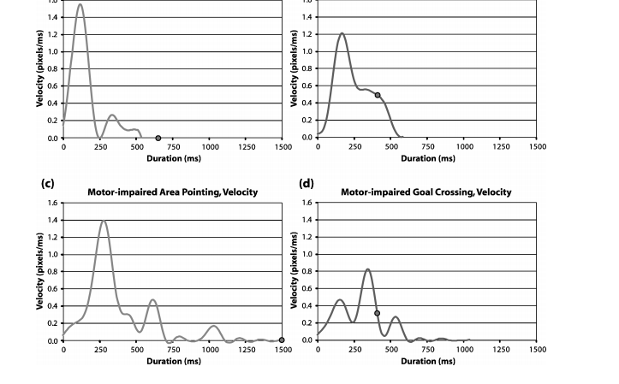
Domain matters: Min-jerk profile
Jacob O. Wobbrock and Krzysztof Z. Gajos. 2008. Goal Crossing with Mice and Trackballs for People with Motor Impairments: Performance, Submovements, and Design Directions. ACM Trans. Access. Comput. 1, 1, Article 4 (May 2008), 37 pages. DOI=10.1145/1361203.1361207 http://doi.acm.org/10.1145/1361203.1361207
Notes:
Fig. 17. Velocity proﬁles over time using the mouse for (a,b) able-bodied participants and (c,d)
motor-impaired participants. The dot represents the click or crossing event. The graphs on the
left are for area pointing. The graphs on the right are for goal crossing.

Slide 27
Is your data Correct?
Are the values correct?
Itemize aspects of your data that are easy to verify
Determine which are important
Understand how much of your data may be incorrect
Decide what to do with bad data
Identify more subtle sources of error:
Proxy reporting: Making use of one sensor (or respondent) to fill in for another
Sample selection: The data is not taken from a representative sample of the population
Notes:
How does correctness differ from coherence? Correctness asks whether its representation of the world is close to how the world actually is…

Slide 28
Draw from many sources
Do the values match your understanding of the units?
Do they match past work? Keates (2005): Able ~112; Older 271; Motor 316
 | Game |  | Internet |  | MS Office
 | Mean (ms) | SD | Mean (ms) | SD | Mean (ms) | SD
Able |  |  | 147.236 | 15.912 | 128.526 | 10.1733
Older | 226.845 | 72.801 | 221.076 | 63.239 | 163.282 | 30.4858
UCP | 406.756 | 285.245 | 391.059 | 128.410 | 290.252 | 74.4451
Notes:
Example scripts to address each of these?

Slide 29
Solutions and Issues for Proxy Reporting
Finding the error:
Mainly an issue in surveys where the respondent may not be who you think.
Sometimes intentional when your sensor breaks down, etc.
Addressing its impact:
Is it random or does it introduce bias
Is it more likely in some variables than others
Is there a specific type of error you expect?
Can you ask people in surveys if they are doing it?

Slide 30
Solutions and Issues for Sample Selection
Finding the error:
How was the data collected
Who was included
How were they selected?
Addressing its impact:
If it is your sample, pay careful attention to how you select participants
Is it random or does it introduce bias
Is it more likely in some variables than others
Is there a specific type of error you expect?

Slide 31
Is your Data Accountable?
Do you understand the provenance of the data?
Have you protected any end users or other people who could be traced?
Can you back up your claims about the data?
Do you have the original data as well as any modifications (version control?)
Who has access to the data?

